Slide 1
General Analysis
Daniel’s first takes on the OPEC sim.
This deck contains my personal opinions. Many may be wrong. Feel free to discuss with me / give feed back in the group chat!

Slide 2
Prerequisite
This deck assumes you have finished reading the 2-page handout “Instruction for OPEC Simulation”.
This is not mentioned in the handout, but Prof. Seamans also said that there would be “communications among the countries”.

Slide 3
The vibe of the game
Among the three markets (A, B, C), there is competition.
Within each market (e.g. A), there is competition and collaboration.

Slide 4
The vibe of the game
Two moves:
Be nice: Maximize the aggregate profit of OPEC in this market.
Be selfish: Maximize my own profit.

Slide 5
The vibe of the game
Two moves:
Be nice: Maximize the aggregate profit of OPEC in this market.
Be selfish: Maximize my own profit.
If market A collaborates better than market B, all members in market A is going to perform better than market B.
However, each member in market A would like to be selfish to get ahead of other members in market A.

Slide 6
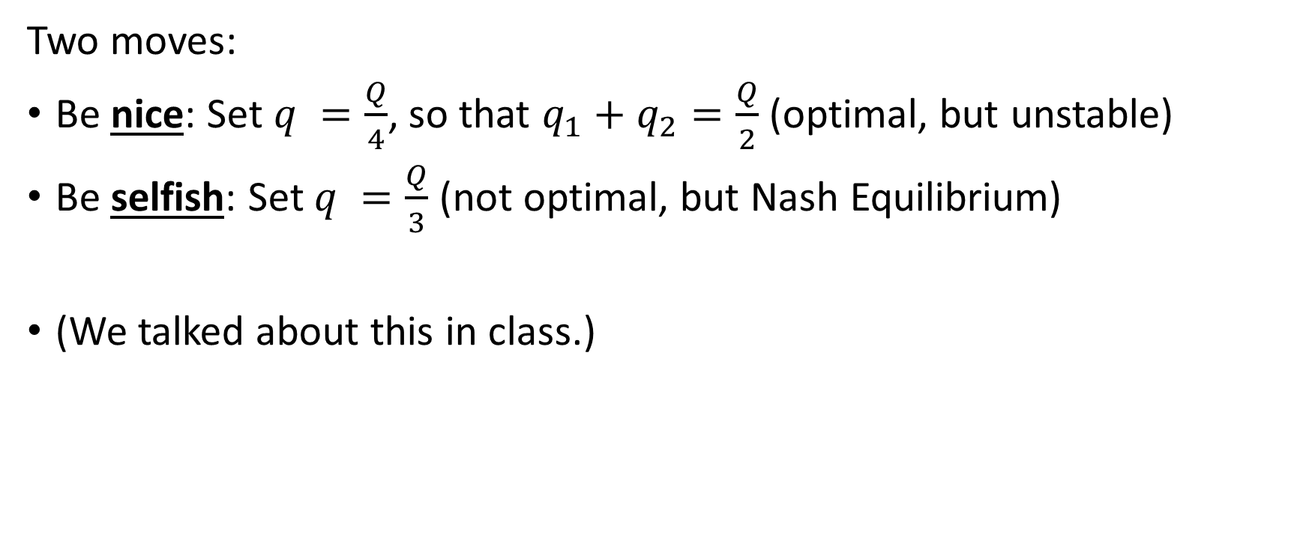
e.g. When there are two players
Two moves:
Be nice: Set $q =\frac{Q}{4}$, so that $q_{1}+q_{2}=\frac{Q}{2}$ (optimal, but unstable)
Be selfish: Set $q =\frac{Q}{3}$ (not optimal, but Nash Equilibrium)
(We talked about this in class.)

Slide 7
Conclusion
Use collaboration to win other markets.
Do selfish actions to win other countries in the same market.

Slide 8
Next topic

Slide 9
Non-strategic player
Iraq in Market B and C always maximizes production (3700). If this surpasses the “be nice” level of output, then Market B and Market C are less favorable than market A.

Slide 10
Next topic

Slide 11
Auction
My argument is: suppose everyone is rational, the auction is supposed to offset any endowed advantages of all the countries so that every player is equal.
See Appendix I for proof.

Slide 12
Auction
My argument is: suppose everyone is rational, the auction is supposed to offset any endowed advantages of all the countries so that every player is equal.
See Appendix I for proof.
Hence, to price the countries:
1. Assume the worst country is worth $0.
2. Price all the countries.
3. Increase all the prices by $100m (lowest bidding price to get a country)

Slide 13
Auction
However, people in this class are not rational. Prof. Seamans’s comments hinted that in previous years Saudi Arabia was significantly overpriced. (first observed by Harry)
As a consequence, to get an advantage in the auction, there are three things we can do:
Price the countries more accurately than other groups.
Make other groups under-evaluate a country, then buy that country with a price lower than our evaluation.
Make other groups over-bid. Make them pay!!!

Slide 14
Auction
Price the countries more accurately than other groups.
Make other groups under-evaluate a country, then buy that country with a price lower than our evaluation.
Make other groups over-bid. Make them pay!!!
(1) is a must-do.
I personally believe (2) is much harder to accomplish than (3), because overbidding is the natural tendency (winner’s curse). I recommend we seek strategies to fulfill (3).

Slide 15
What we do during the auction
Bid for those that are lower than our valuation.
Because there is a chance to get a cheap deal, we may want to stop bidding if the first few countries go to 90% of our valuation. When the auction is nearing the end, always bid when the price is lower than our valuation. (ofc, if everyone thinks like this, we’d better not)
NEVER bid when the price is higher than our valuation.

Slide 16
Potential methods to make others overbid
“Evil Communication” is the key.
Release valuation reports. Over-evaluate the countries in the report.
Fake poll. I can write a website for teams to anonymously submit their valuations and show the average valuation. The website claims to “provide information about people’s valuation prior to the auction”. We secretly manipulate the data to make the average valuation look high.
在 auction 进行的时候，“带节奏”。During the auction, bid in a way that gets on other groups’ nerves. (I don’t know too much about this one.)

Slide 17
Next topic

Slide 18
The gamethrow effect: losers are dangerous!
What happens when a group is super behind on accumulated profit?
(Maybe they bid wayyyy too high. Maybe they accidentally produced 0 for one period.)

Slide 19
The gamethrow effect: losers are dangerous!
What happens when a group is super behind on accumulated profit?
(Maybe they bid wayyyy too high. Maybe they accidentally produced 0 for one period.)
They know they are going to lose for sure.
Then, the loser team would not have any incentive to act rationally. Other members in the same market would have no meaningful economic punishment for the loser to regulate the loser’s behavior, since the loser does not care anymore.
Conclusion: a severely disadvantaged group would bring hazard to its market.

Slide 20
The gamethrow effect: losers are dangerous!
Insights:
Although we want to get ahead of other countries in the same market, we shouldn’t allow any particular country in our market to 翻车.
If we could somehow lead a country in another market into a failing trajectory, then that market would have to face the gamethrow hazard.
More generally, increasing inequality in other markets = successful sabotage.

Slide 21
The gamethrow effect: losers are dangerous!
Implication on auction:
If a group bids 1 trillion on a country, stay away from that market lol
More generally: dynamically adjust our valuation as the auction unfolds. Any significant overbidder should devalue all countries in that market.

Slide 22
Next topic

Slide 23
Potential ways to sabotage other markets
Break trust. Plant doubt. Spread misinformation.
Honest people like we are will not do this in life, so let us cherish this OPEC sim opportunity and have some fun!
We can brainstorm on this later.
My ideas includes “falseful data reports and accusations” “impersonate anonymous regulator” “disclosure of fabricated collusion”

Slide 24
Next topic

Slide 25
Within our market
I expect to see some degrees of collaboration for 11 turns, and then full-on selfish behaviors for the rest. The details will depend on further calculations.
Because the submitted quantities are not public and the released aggregate production is rounded (see handout), we should produce slightly higher than the “be nice” level, even when we choose to look nice. (This is the main game that Prof wants us to play. We should discuss on this more as a group.)
Next level: how do we promote collaboration?
How do we let everyone be nice?

Slide 26
One solution: persuasion and reasoning
Construct friendly relations with other countries in the same market.
Show our analysis. Show our math. Argue that collaboration is important to win the game.

Slide 27
One solution: promised retaliation
Remember “grim trigger”?
We claim that once we observe any selfish behavior, we will punish the offender.
This requires the market players to form a common. If player 2 offends, then player 1 3 & 4 collectively punishes 2 in the next period. The rules of punishment should be made clear among the four players in advance. Retaliation should be targeted, temporary, and forgiving. (See Charles Dawkins’s analysis on Prisoner’s Dilemma ESS)

Slide 28
One solution: ega-cartel
First, assume that countries may commit to contracts (which is not the case in OPEC sim).
Suppose all countries in market A agrees to this contract: at the end of each period, evenly split the total profit among the four countries through direct money transfer.
In this scenario, maximizing one’s own profit is equivalent to maximizing the total profit of OPEC in market A. The four players would act like a perfect cartel.

Slide 29
One solution: ega-cartel
Now, relax the counterfactual assumption about contracts.
Can we enforce the direct money transfer through promised retaliation?
More discussion is very welcome.
A technical note: of course, the “even split” takes the initial bidding price into account. The idea is for every player to be equal in terms of chance to win.

Slide 30
One solution: ega-cartel
The advantage of ega-cartel is to eliminate inner doubt. This is highly significant.
Without ega-cartel, even if all countries wish to be “be nice”, as long as their math turns out to be different, there can still be dispute, and each country will doubt if other countries are actually trying to “be nice”.
The invisibility of each country’s specific oil output makes it even worse. In games like this, doubt chain (猜疑链) is easily formed and quickly escalated.
However, if all profits are evenly split every period, there would be no incentive to cheat, hence no reason to doubt.

Slide 31
Next topic

Slide 32
Evidence of submitted quantity
When we submit quantity to Prof. Seamans via email, we can choose to close copy (cc.) other countries in the market.
cc. is signed and encrypted by the NYU email service, and cannot be faked, and hence has proving power. (We can also say something like “we waive our rights to resubmit quantity. We demand any further communication about this turn’s quantity submission to be disregarded.” in the email.)
This decreases doubts and stabilizes the cartel.

Slide 33
Next topic

Slide 34
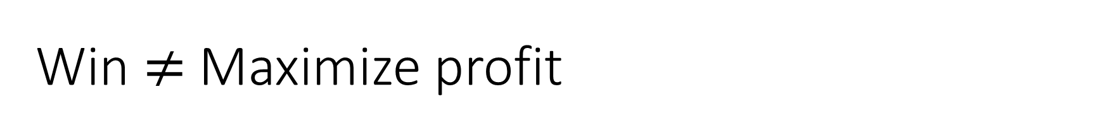
Win $≠$ Maximize profit
Suppose we are in Market A.
The first round ends. It turns out that market B and C are doing way worse than market A. Market A is taking the lead.
Win = to be the first. So market A only needs to be slightly better off than the second best market.
In this situation, we may want to temporarily ignore the competition between markets and construct advantage over the other countries in market A.

Slide 35
Win $≠$ Maximize profit
Suppose we are in Market A.
The first round ends. It turns out that market B and C are doing way worse than market A. Market A is taking the lead.
Win = to be the first. So market A only needs to be slightly better off than the second best market.
In this situation, we may want to temporarily ignore the competition between markets and construct advantage over the other countries in market A.
However, others may think alike, risking market A to lose the lead, or even get stuck in retaliation cycles.

Slide 36
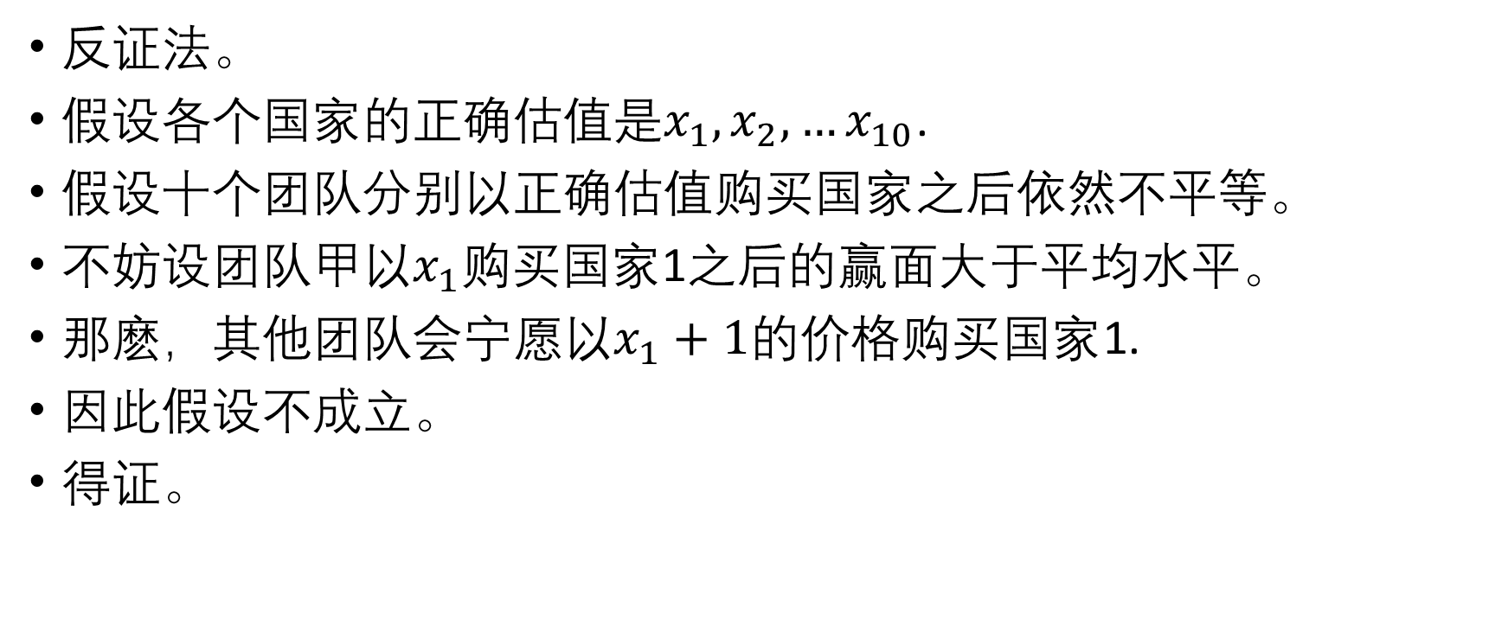
Appendix I. Proof 中文
反证法。
假设各个国家的正确估值是$x_{1}, x_{2}, …x_{10}$.
假设十个团队分别以正确估值购买国家之后依然不平等。
不妨设团队甲以$x_{1}$购买国家1之后的赢面大于平均水平。
那麽，其他团队会宁愿以$x_{1}+1$的价格购买国家1.
因此假设不成立。
得证。

Slide 37
Thank you for viewing!
I typed everything in a hurry. If you find any mistakes, please point out.

